Slide 1
Team General LA Parking Citation Frequency
By: Diane Margo
Michael Tang
Jerry Trieu
Ocean Lu

Slide 2
Source and Information
Cloud platform: XSEDE & Hadoop
Big data problem: LA Parking citation and frequency
Dataset: https://www.kaggle.com/cityofLA/los-angeles-parking-citations
Size: 1.35 GB
Columns: Ticket number, Issue Date, Issue time, Meter Id, Marked Time, RP State Plate, Plate Expiry Date, VIN, Make, Body Style, Color, Location, Route, Agency, Violation code, Violation Description, Fine amount, Latitude, Longitude, Agency Description, Color Description, Body Style Description

Slide 3
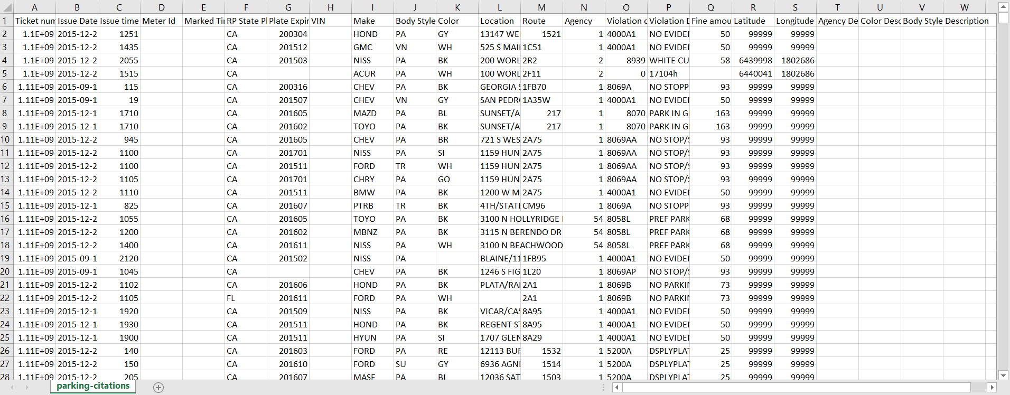
Data From Kaggle

Slide 4
Hadoop commands
Start hadoop: interact -N 4 -t 01:00:00; module load hadoop; start-hadoop.sh
Create a directory to store input files in the HDFS: hadoop fs -mkdir -p in
Load file to the HDFS storing it in the 'in' directory: hadoop fs -put parking-citations.csv in
Give permission: chmod +x mapper.py; chmod +x reducer.py
Execute the program: hadoop jar /opt/packages/hadoop-testing/hadoop/hadoop-2.7.3/share/hadoop/tools/lib/hadoop-streaming-2.7.3.jar -input in/parking-citations.csv -output out/time -mapper mapper.py -file /home/oslu/mapper.py -reducer reducer.py -file /home/oslu/reducer.py
To retrieve the file: hadoop fs -get out/time/part-00000 /home/oslu

Slide 5
Data Studies
Top Time to be Ticketed
Top Vehicle Make/Color to be Ticketed
Frequency of Tickets on a Given Date
Frequency of Certain State Licence Plates
Most Cited Location
Most Frequent Violation Description

Slide 6
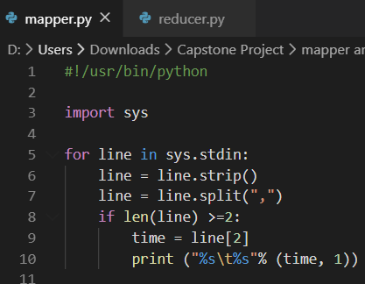
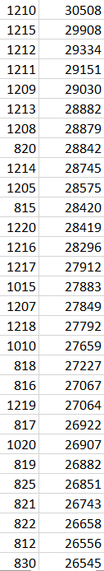
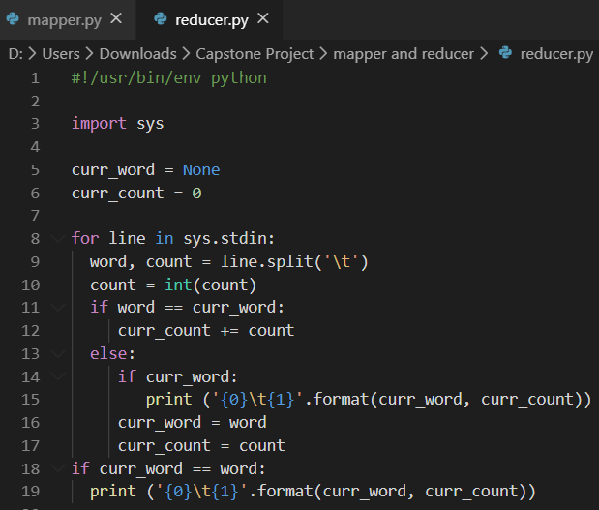
Top Time to be Ticketed: Results
Results: 12:10 PM is the top time to be ticketed (Data is displayed in military time)
Mapper:
prints out all times with a count of 1
Reducer:
Process each key-value pair from the mapper
Get the key and value from the current line
Convert the count to an int
If current word is same as previous word, increment count
Write word and its number of occurrences as key-value pair to stdout

Slide 7
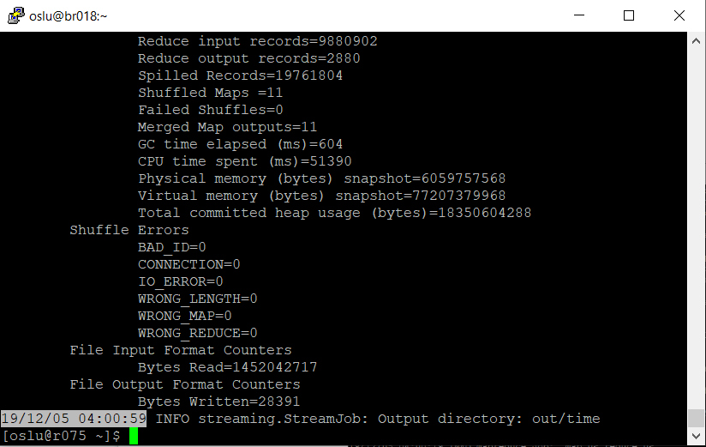
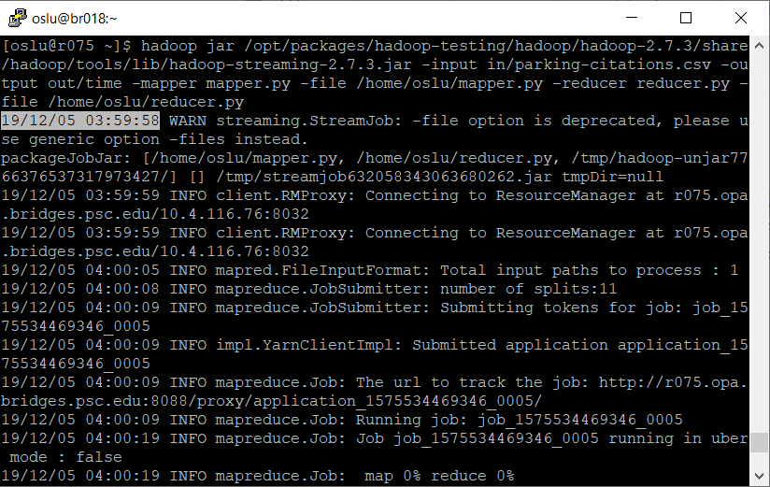
Top Time to be Ticketed: Execution Time
Execution Time: 1 minute and 1 second 19/12/05 04:00:59 - 19/12/05 03:59:58 = 00:01:01

Slide 8
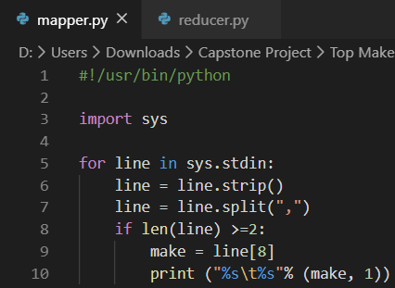
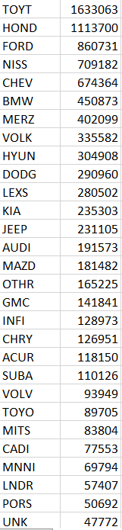
Top Vehicle Make to be
Ticketed: Results
Results: Toyota is the top vehicle make with 1,633,063 documented vehicles
Mapper:
prints out all vehicle makes with a count of 1
Reducer:
Process each key-value pair from the mapper
Get the key and value from the current line
Convert the count to an int
If current word is same as previous word, increment count
Write word and its number of occurrences as key-value pair to stdout

Slide 9

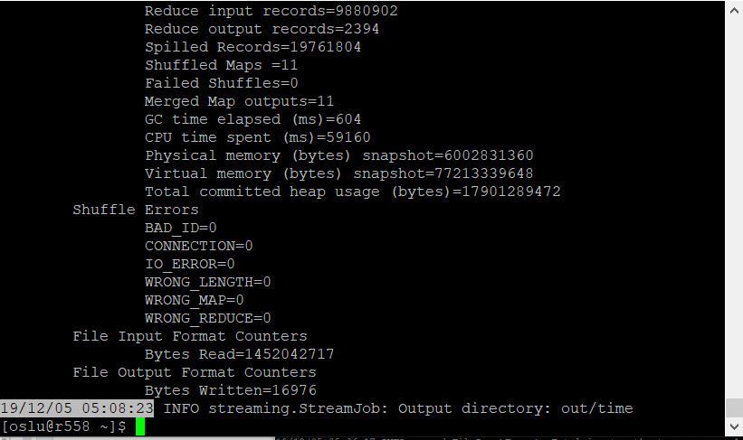
Top Vehicle Make to be Ticketed: Execution Time
Execution Time: 2 minutes and 11 seconds 19/12/05 05:08:23 - 19/12/05 05:06:12 = 00:02:11

Slide 10
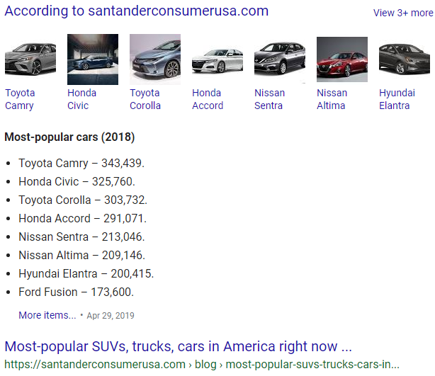
Top Vehicle Make to be Ticketed:
Applied
Results showed Toyota, Honda, Ford, and Nissan were most popular to be ticketed
The top makes to be ticketed was also the most popular cars to get in the US

Slide 11
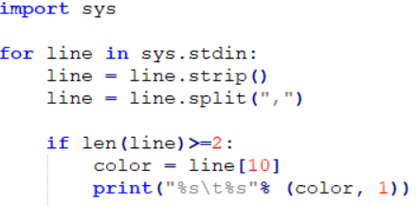
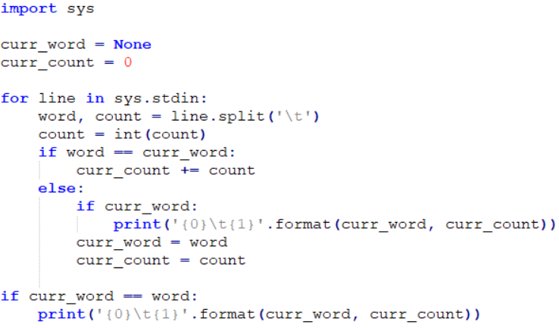
Top Vehicle Color to be
Ticketed: Results
Results: Black is the top color with 224,005 documented vehicles
Mapper:
prints out all vehicle color with a count of 1
Reducer:
Process each key-value pair from the mapper
Get the key and value from the current line
Convert the count to an int
If current word is same as previous word, increment count
Write word and its number of occurrences as key-value pair to stdout

Slide 12
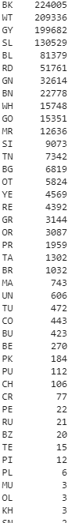
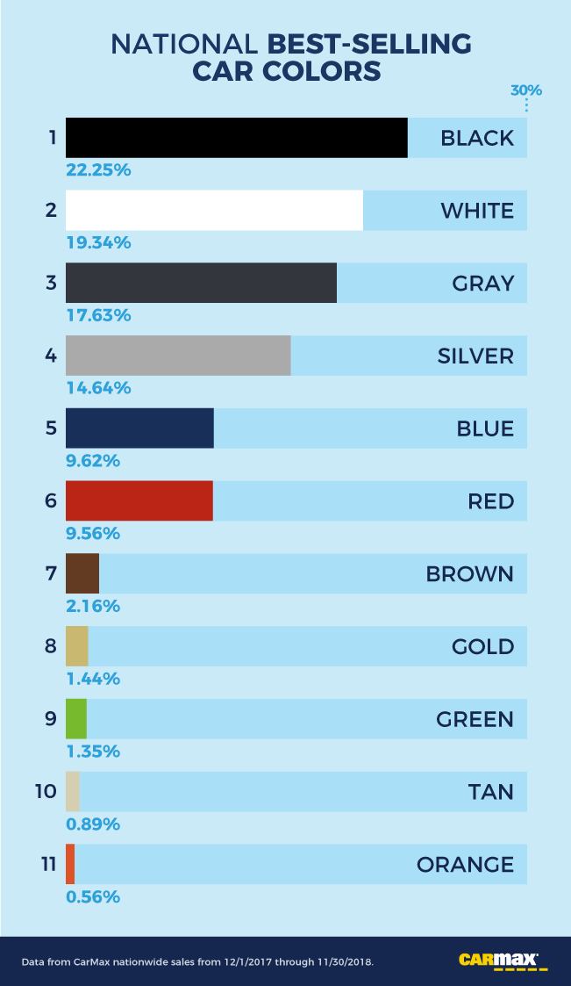
Top Vehicle Color to be
Ticketed: Applied
Results showed black, white, and grey were most popular to be ticketed
The top color to be ticketed was also the most popular cars to get in the US

Slide 13

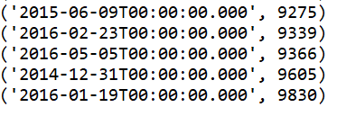
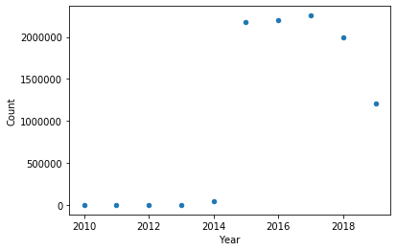
Frequency of Tickets on a given Date
Map Reduce Time: 1:47 Minutes
When you look up the dates on a calendar, some of the dates correspond with a holiday
In this case Cinco De Mayo and New Years Eve

Slide 14
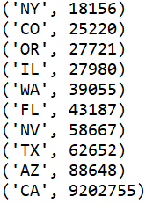
Frequency of certain State licence plates
Since this is citations of LA, it would make sense that CA would be the most
If we ignore CA, the most cited license plates would be AZ, TX, NV which
Make sense because AZ and NV border CA. TX also make sense because they are
The second most populous state in America according to the government Census.
Map Reduce Time: 1:26Mins

Slide 15
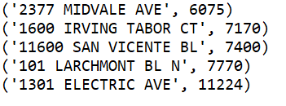
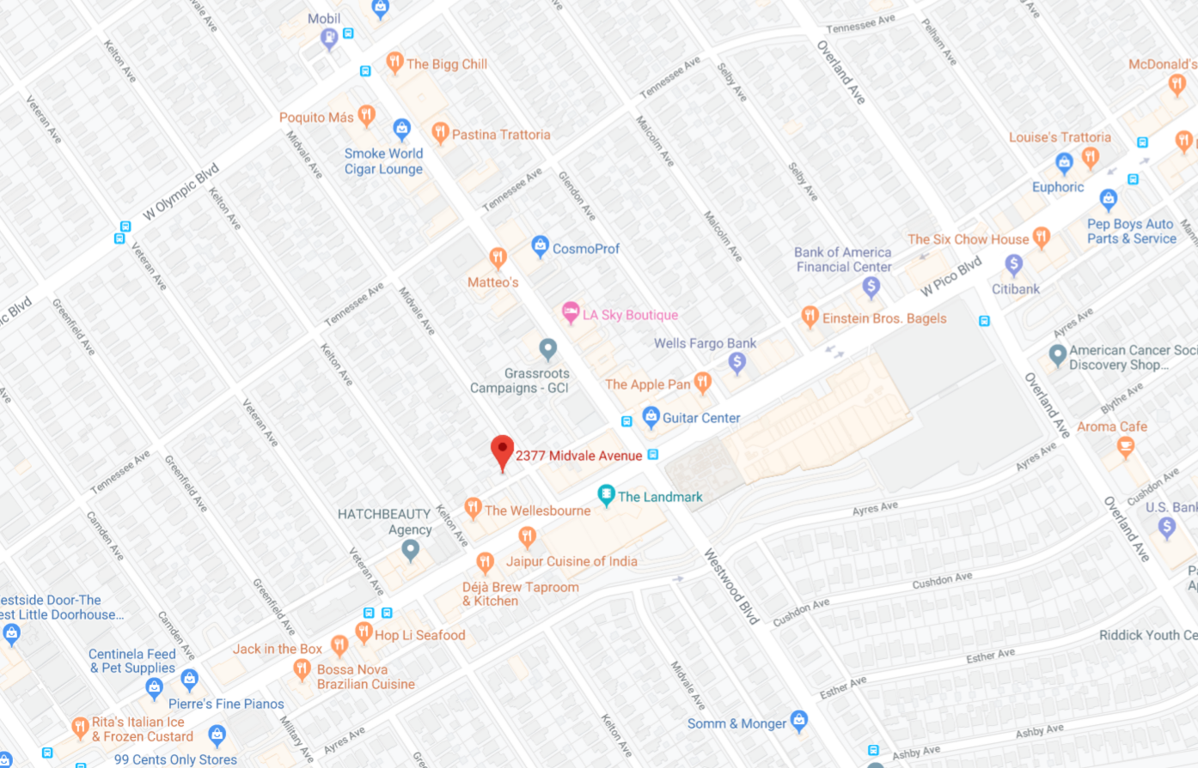
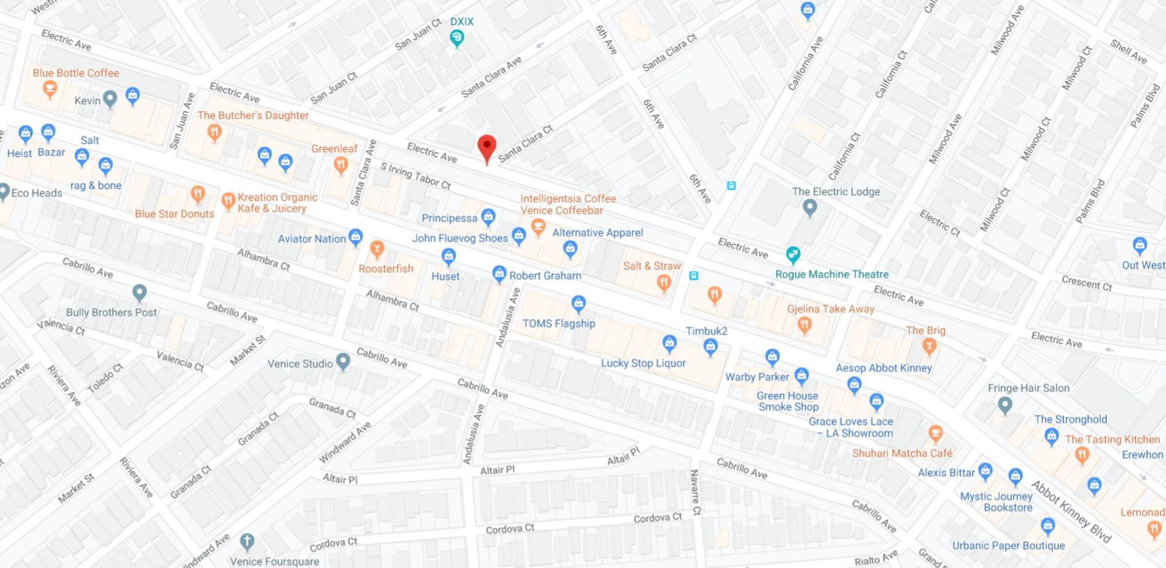
Most Cited Location
Map Reduce Time: 1:46Min
It seems the most cited location specifically is near
Venice Beach even more specifically near places to shop
What all these places have in common with each other is
They are all near places to shop or eat

Slide 16
Most Frequent Violation Description
Implemented Map-Reduce programming similar to previous problems, with very small changes to the code.
Mapper - Essentially printed out all frequent violation description with a count of 1
Reducer - processed each key-pair from mapper, and printed out each violation description along with its frequency
Combined some data results because they were essentially the same description
Ie: METER EXP. & METER EXPIRED, PARKING OVER TIME LIMIT & PARKING OVER TIME LIM

Slide 17
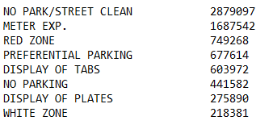
Most Frequent Violation Description Pt. 2
Map - Reduce time : 1:49 secs
Since restaurant/shop locations have the most frequent tickets, it might have a correlation with meter expiration and no park/street clean areas.
LA is a very busy city, with many places not having enough parking spaces in their parking lots to accommodate customers, which could explain parking in the red & white zone.

Slide 18
Thanks for listening
Have a great day!

